Slide 1
Customer Insight and Predictive analytics Using Apache Spark
Sathishbabu Rajasekar ( sxr136330) Upendra Reddy Lingareddygari (uxr130130) Viswatej Reddirouthu (vxr131330) Samhita Muthineni(sxm130331) Divya Ramadugu (dxr131330)

Slide 2
Overview of the project
The proposed project is to gain customer insight and predictive analytics on phones based on trending tweets from Twitter using Spark and MLib.
Inputs are the live tweets from Twitter and with help of Spark we find the tweets relevant to phones matched using hash-tags and tweet text.
These tweets are then classified using naïve bayes classifier for sentiment analysis.
Upon classification, user id’s of supporters and non-supporters for different phone models are provided.

Slide 3
TECHNOLOGIES USED
Apache Spark
Mlib
Twitter4j

Slide 4
APACHE SPARK
Apache Spark is an open-source cluster computing framework originally developed in the AMPLab at UC Berkeley.
It provides the in-memory cluster computing that allows user to load data into a cluster's memory and query it efficiently.
In contrast to Hadoop's two-stage disk-based MapReduce paradigm, Spark's in-memory primitives provide performance up to 100 times faster for certain applications.

Slide 5
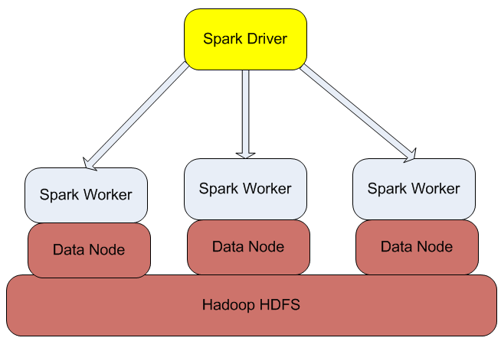
Spark architecture

Slide 6
KEY CONCEPTS OF SPARK
Resilient Distributed Datasets(RDD)
Directed Acyclic Graph(DAG) execution engine

Slide 7
RDD
It is a distributed memory abstraction
Spark has two types of RDDS:
Parallelized existing programming collections (like list, map, etc)
Files stored on HDFS

Slide 8
DAG EXECUTION ENGINE
Whenever the user runs an action on RDD, a directed acyclic graph is generated considering all the transformation dependencies
This eliminates the traditional MapReduce multi-stage execution model and also improves the performance

Slide 9
MLIB
MLib is Apache Spark's scalable machine learning library.
It consists of common learning algorithms like classification, clustering, regression, dimensionality reduction etc.
We have used the MLib-Naïve Bayes Algorithm for classification.

Slide 10
Mlib-Naïve bayes
Is a simple multiclass classification algorithm
It assumes independence between every pair of features
It can be trained very efficiently
Within a single pass to the training data, it computes the conditional probability distribution of each feature given label, and then it applies Bayes’ theorem to compute the conditional probability distribution of label given an observation and use it for prediction.

Slide 11
Twitter4j
Unofficial Java library for Twitter API
Fetches near real time data from twitter using developer credentials

Slide 12
THANK YOU!

